Slide 1
Oliver Bowker DC4400 Viva
Extension of the BBC iPlayer off product schedules system to process change notifications

Slide 2
About Me

Slide 3
About the BBC

Slide 4
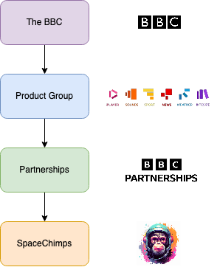
Place in the organisation
I am part of team SpaceChimp which is part of the partnerships group, which itself is part of the overall product group.

Slide 5
What we do as a team?
We provide APIs, of which we also generate the data, for off-product (non-iPlayer) related partners.
Catalogue pipeline (Contains episode, series and brands)
Different timescales/horizons, 0-day, 8-day and unfiltered.
Schedule pipeline (Contains schedules)
1 schedule, per day, per service.
Each schedule contains a list of broadcasts.
Each broadcast has titling, programme description and viewer discretion warnings for said broadcast/programme of which it relies on the catalogue pipelines data.
VSK Alexa functionality

Slide 6
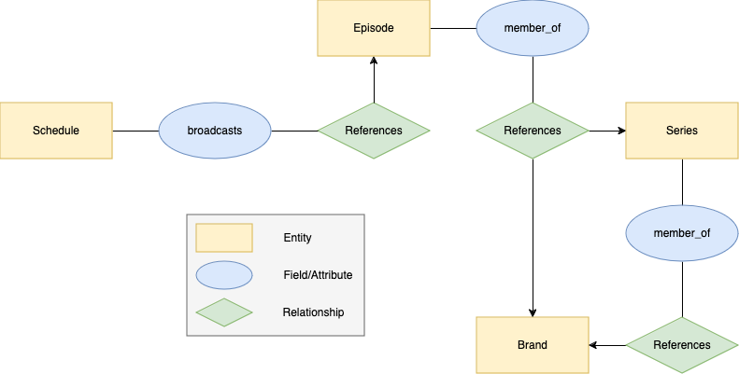
How the data links together?

Slide 7
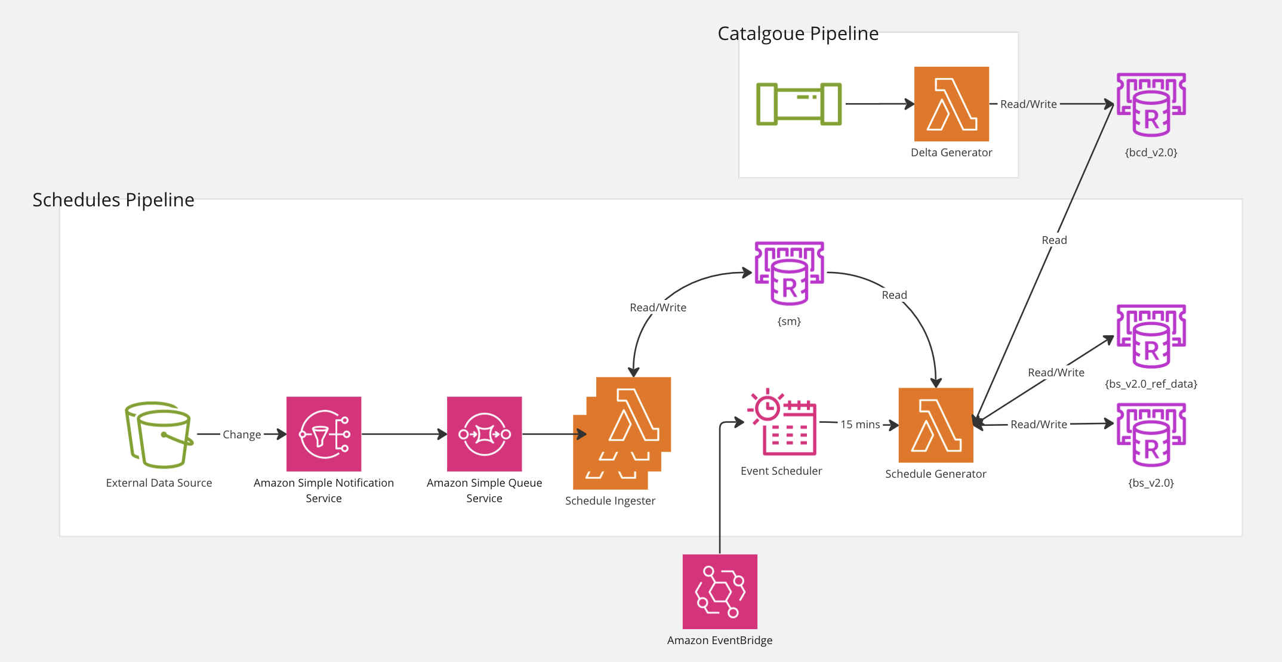
Starting architecture

Slide 8
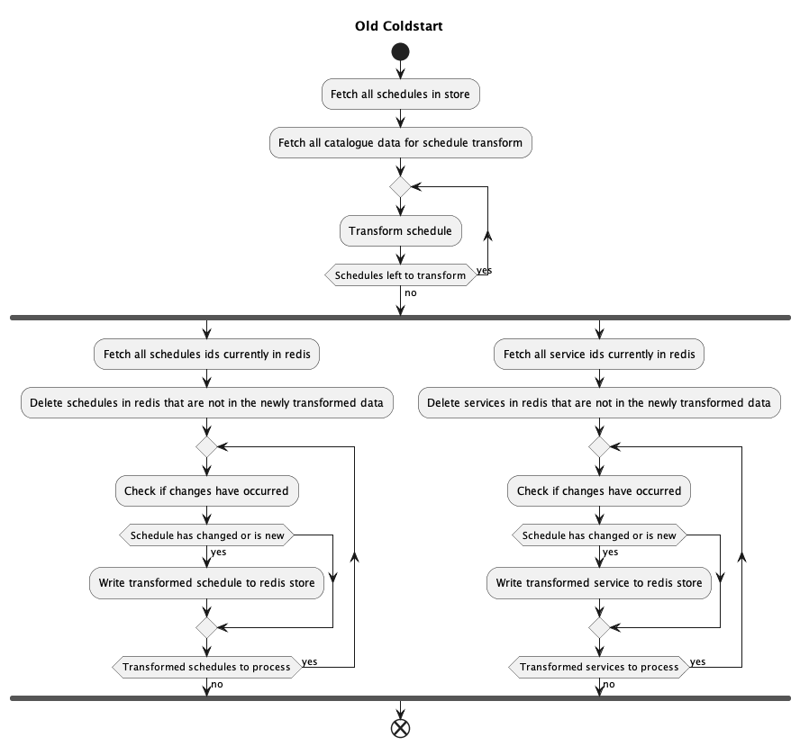
Old functionality
Data is fetched from an internal model and transformed into its external format every 15 minutes.
This transformed data includes the schedule itself as well as the service (e.g., BBC1) that the schedule is for.

Slide 9
Project Goals
Update the schedule generator away from a static generation approach to an event/notification-based system.
1
Have schedule data for partners be as up to date as possible.
2
Allow notifications direct to partners in future work.
3

Slide 10
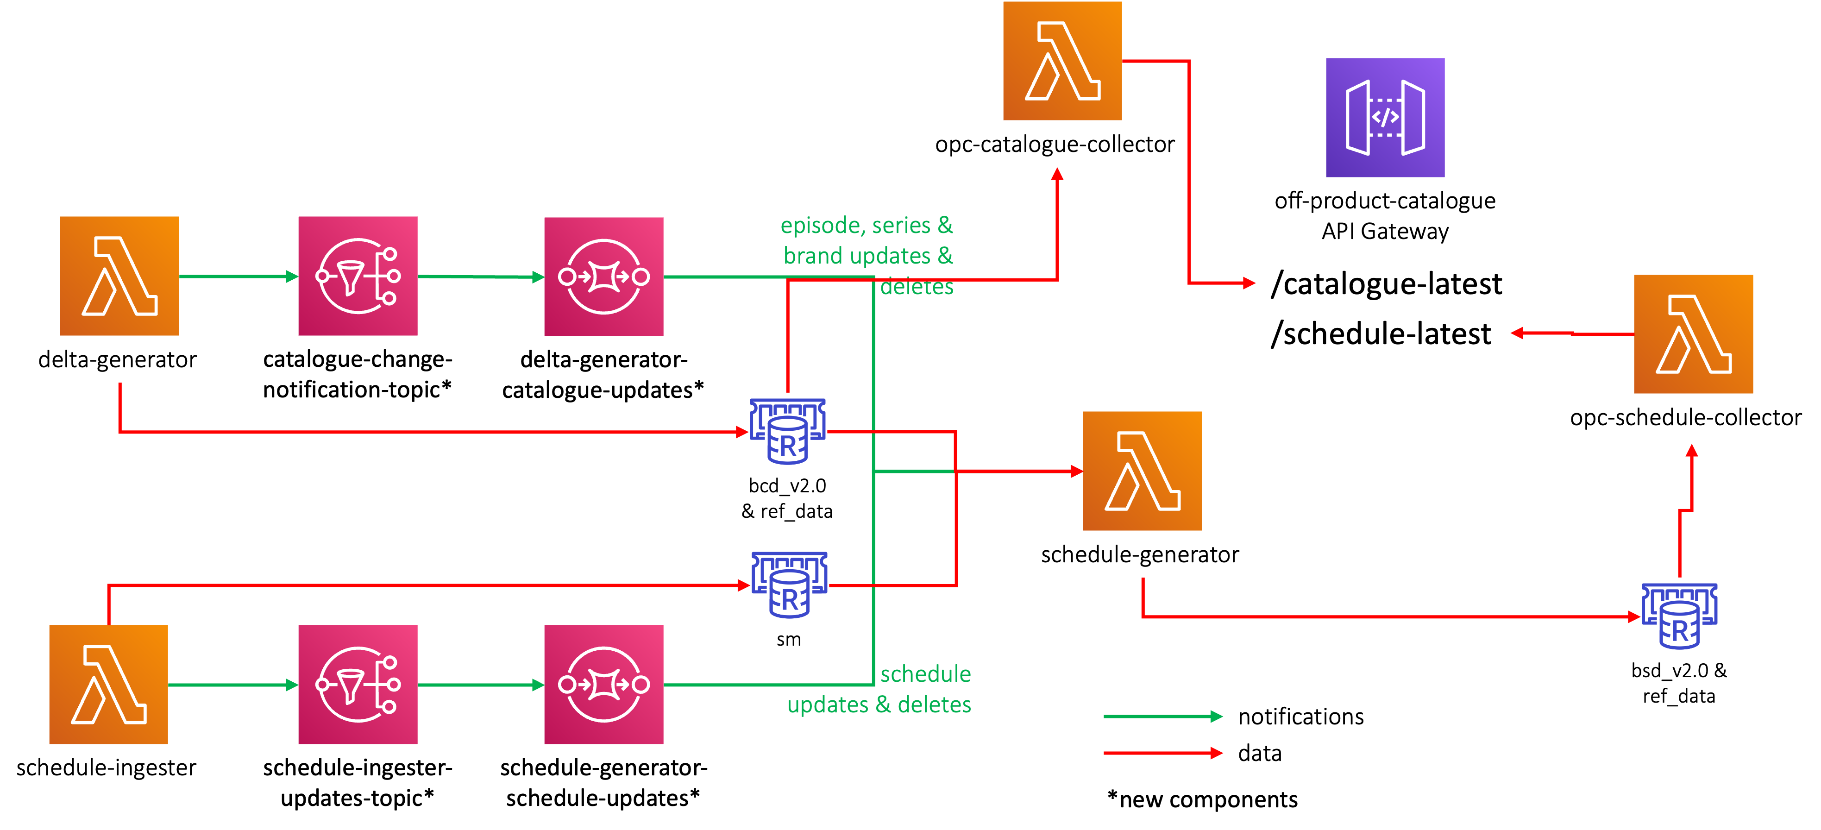
Initial Design

Slide 11
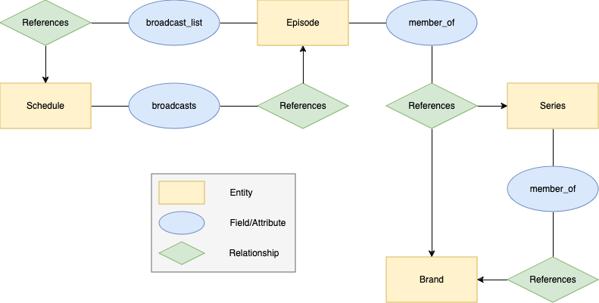
Handling titling changes
A list of schedules is to be kept per episode that is referenced in a schedule's broadcasts.
When an episode update is processed by the schedule generator, schedules that reference it can also be easily updated.
This keeps the data correct and doesn’t rely on schedule updates alone to update titling and other catalogue related fields.

Slide 12
Initial Architectural Decision
An architectural decision was made to have all data referenced in a schedule be in the same Redis key space/store.
This results in copying over episode, series and brand data related to schedules from the catalogue store over to the schedule store.
This ensures the API Gateway can retrieve all its information from one source and keep its integrity and self-consistency.
This also allows us in the future to edit this data per pipeline, changes can be made to the schedules episode schema without breaking current catalogue integrations.

Slide 13
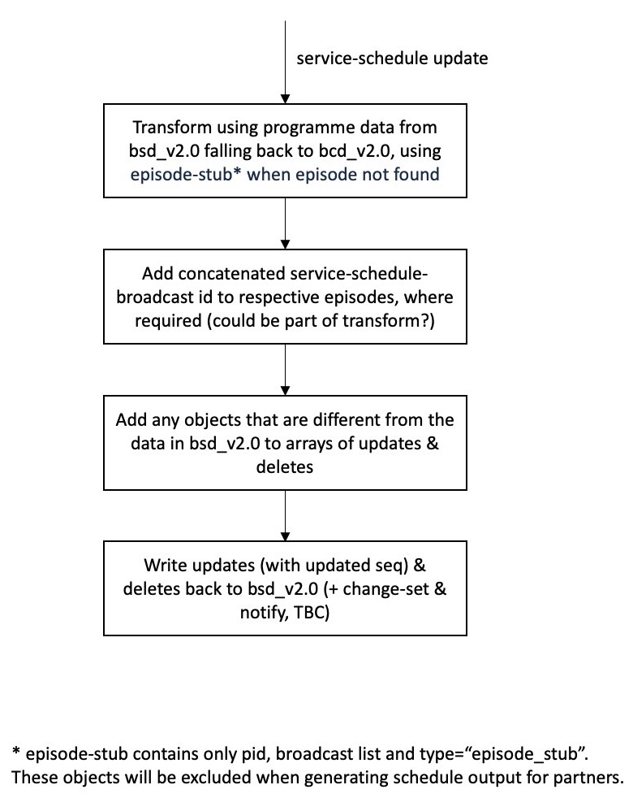
Initial Algorithm: Schedule Update Notifications

Slide 14
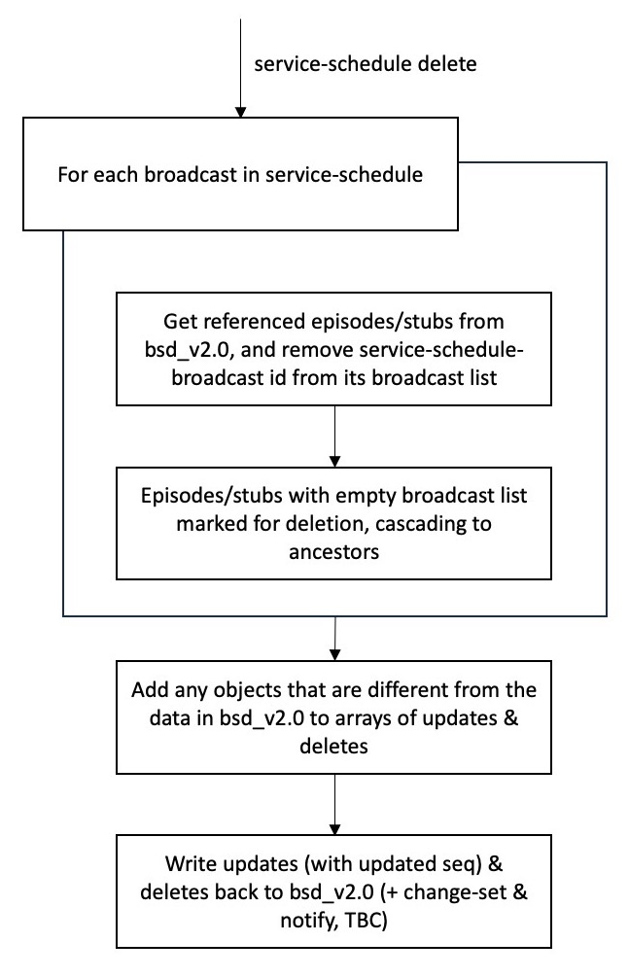
Initial Algorithm: Schedule Delete Notifications

Slide 15
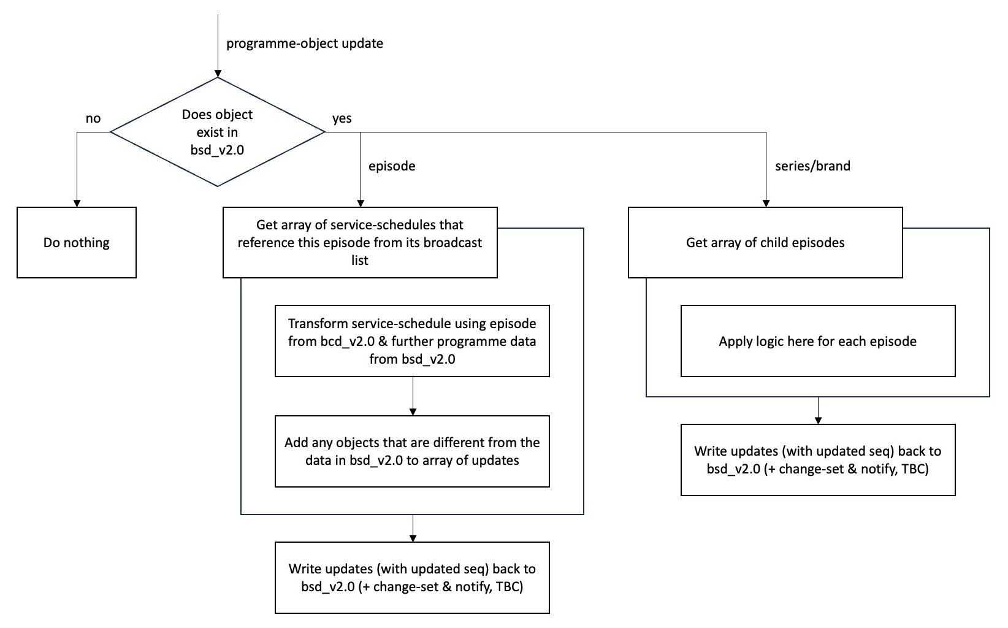
Initial Algorithm: Catalogue Notifications

Slide 16
Constraints
Initial Architectural Decision
Time
Single threaded

Slide 17
Software Spike (Changes)
A spike was done to improve and test the proposed architecture and algorithm outlined in the initial design. This was done by myself, and a fellow junior software engineer and the following changes were made to the initial design:
Catalogue delete notifications did not need to be handled as they could be handled by schedule notifications.
A ‘garbage collector’ could be used to lower the complexity and number of Redis gets when removing an episode. Only schedules and episodes are to be removed by the schedule generator, with series and brands being removed by the garbage collector.
Schedules updated due to an episode notification should be done concurrently to save time.
Only need one queue for the schedule generator, not 2 as was depicted in the initial architecture design.

Slide 18
Software Spike (Issues)
Copying the data between Redis’ added significant complexity to the code.
Due to the broadcast list linking episodes and schedules being stored in Redis, parallelisation in the future will be a challenge.
Unrelated to the code, the spike had no timebox assigned to it, which led to scope creep.

Slide 20
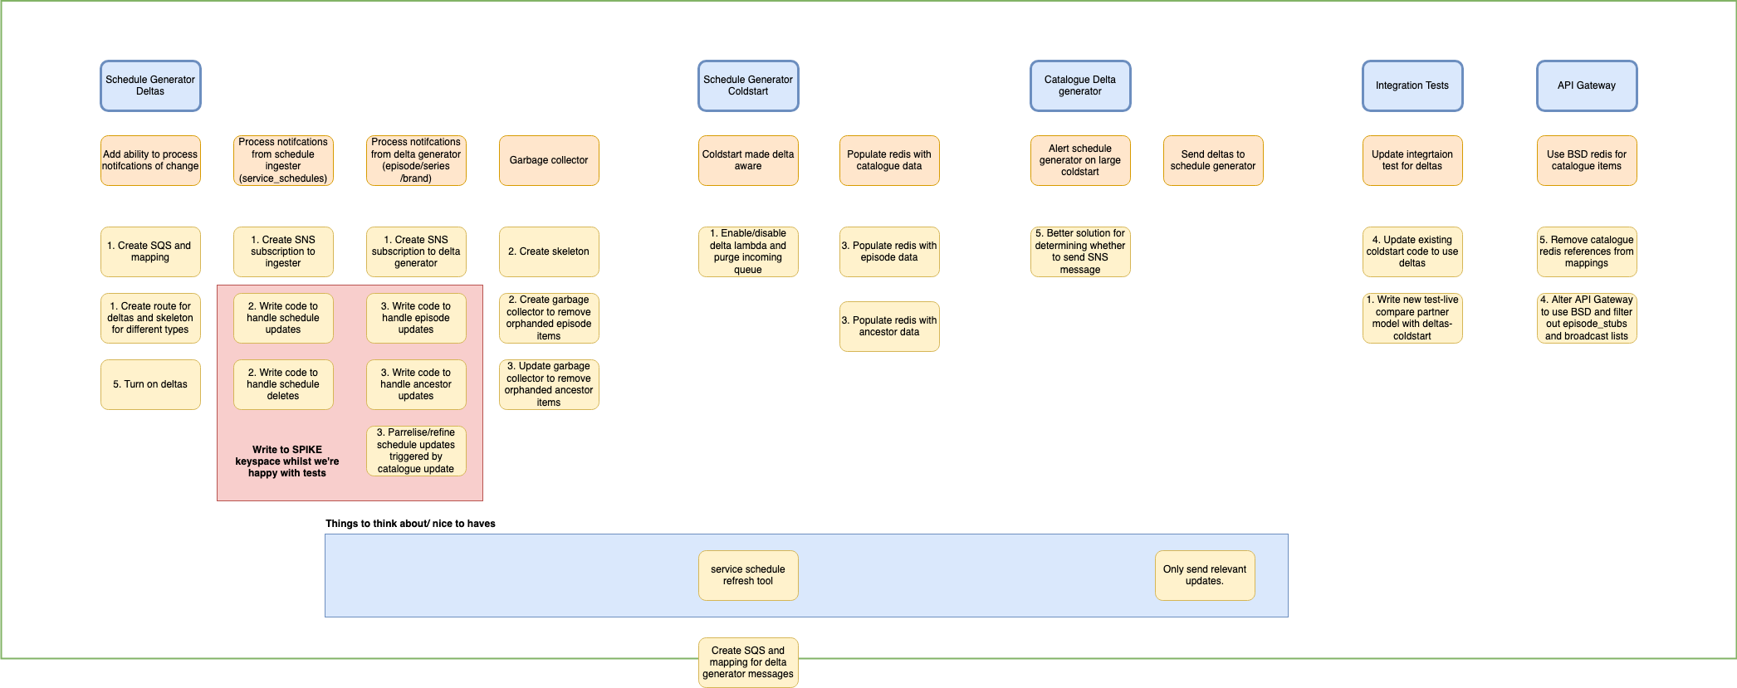
Ticket Slicing

Slide 21
Final Feature Sets
The above diagram was put into Jira tickets and after some conversations and moving around four feature sets were outlined to meet the MVP.
Create infrastructure needed to handle notifications
Handle notifications for schedules (updates/deletes)
Handle notifications for catalogue (updates)
Integration/comparison tests, documentation and switchover to new system

Slide 22
Ticket Slicing /Feature Sets (Challenges)

Slide 23
Notification Lambda

Slide 24
Notification Lambda (Challenges)

Slide 25
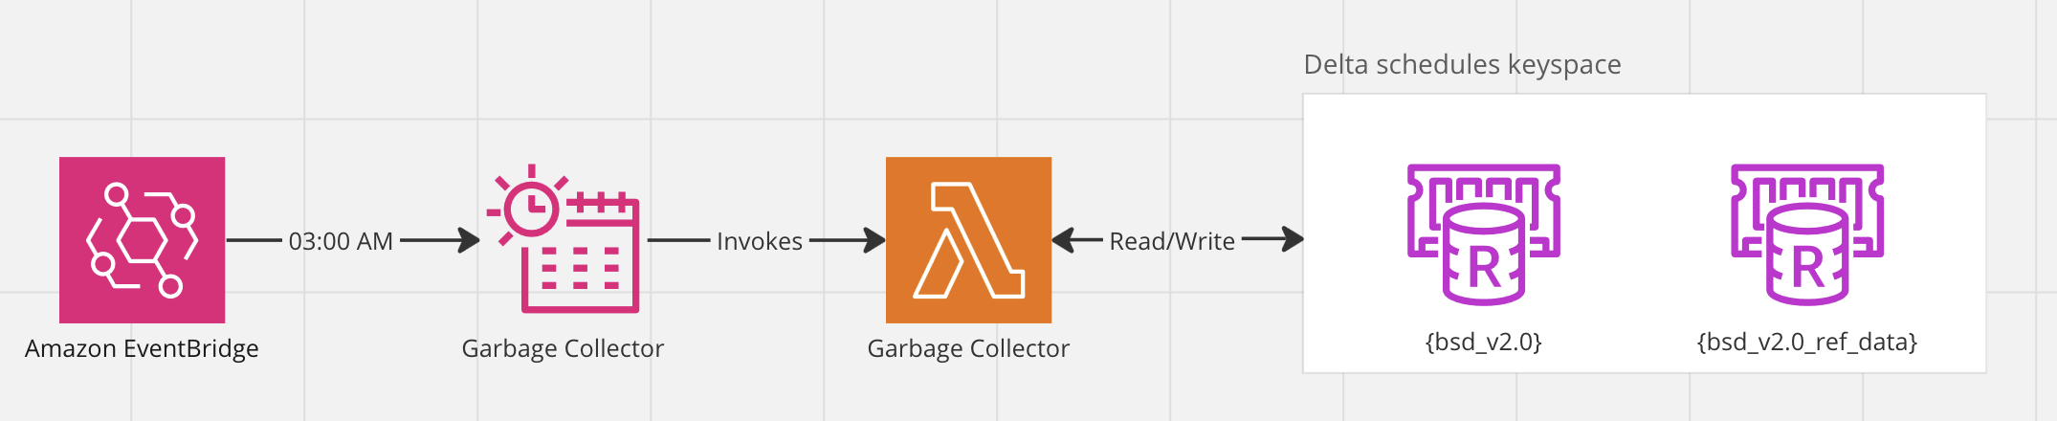
Garbage Collector Lambda
A lambda was created and scheduled to run at 3am everyday to clear up any orphaned series and brands in the schedules store.
A series or brand was determined orphaned if it had no episodes within its tree.
Doing this once a day removes a lot of processing, code complexity and Redis gets from the schedule generator and system.

Slide 26
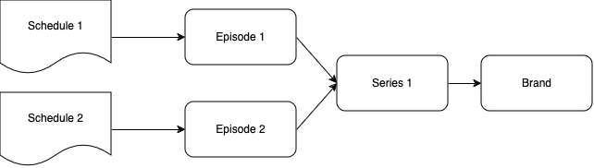
Without a garbage collector
If schedule 1 is removed, episode 1 will also be removed as it’s no longer referenced by any other schedules.
Because the episode is removed, we now need to check the whole tree, to see if the episodes parents (Series 1 and Brand) can also be removed.
Due to the bottom-up nature of referencing (episode → series → brand) all data must be retrieved from Redis to see if anything is still linked to any of the objects.

Slide 27
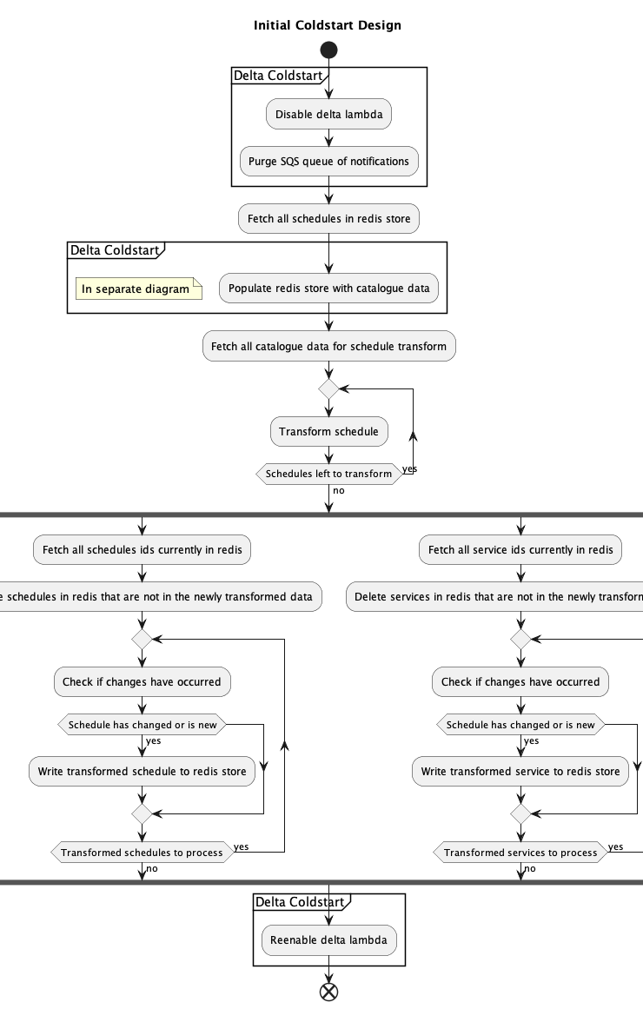
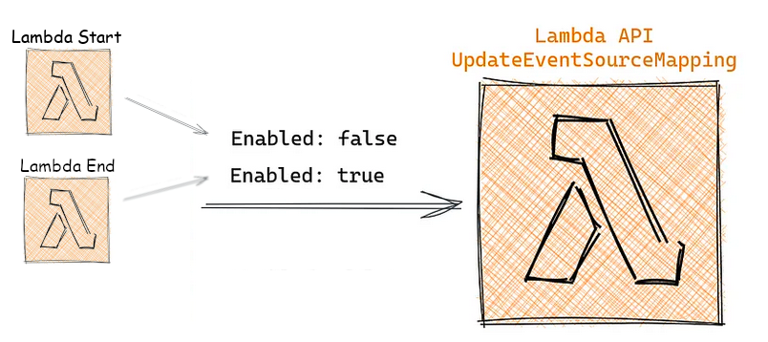
Coldstart Lambda
We are moving our main functionality to an event-based system. However, being able to refresh all data when needed is an important feature to have, data can get to an unfixable state.
The initial design was to build off the current static generation. Temporarily pausing notification processing whilst items in the schedule store were refreshed.

Slide 28
Coldstart Lambda (Challenges)
This design became complex due to the different types of data being stored in the schedule Redis (both catalogue and schedule data).
This was primarily due to the refresh of episodes and managing the list of associated schedules that episode was linked to.
This challenge came up later in development, so a total system re-design was out of the question.

Slide 29
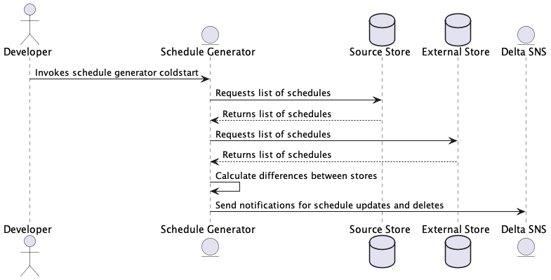
Coldstart Lambda (Solution)
A new solution was devised to re-use the notification lambdas functionality.
On coldstart notifications for all schedules would be re-queued for the notification lambda to process.
If the schedule is not in the source store but is in the external store, a delete notification is sent.
An update notification is sent for every schedule in the source store.

Slide 30
Integration and Comparison Tests

Slide 31
Future Work (Garbage Collector Consolidation)
The current system breaks the principle of separation of concern (SoC).
Schedule generator should be concerned with the deletion of schedules and not the deleting of episodes.
This would also make the schedule generator less complex.
Deleting the episode straight away instead of through the garbage collector has no negative impact on partners, or the output of the system.

Slide 32
Future Work (Allow Parallelisation of Notifications)

Slide 33
Future Work (Changesets/Notifications to Partners)

